Slide 1
Ch 6.
Vectors, Lists, and Sequences
Acknowledgement: These slides are adapted from slides provided with Data Structures and Algorithms in C++, Goodrich, Tamassia and Mount (Wiley 2004) and slides from Nancy M. Amato
Notes:
1
1

Slide 2
Vectors
The Vector ADT (Ch. 6.1.1)
Array-based implementation (Ch. 6.1.2)

Slide 3
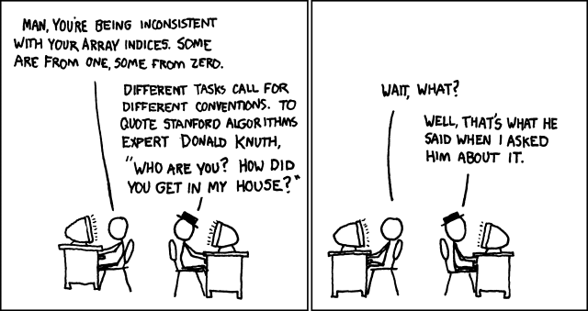
Applications of Vectors
Direct applications
  Sorted collection of objects (elementary database)
Indirect applications
  Auxiliary data structure for algorithms
  Component of other data structures

Slide 4

Vector ADT
The Vector ADT extends the notion of array by storing a sequence of arbitrary objects
An element can be accessed, inserted or removed by specifying its rank (number of elements preceding it)
An exception is thrown if an incorrect rank is specified (e.g., a negative rank)
Main vector operations:
  $\text{at}\left(i\right)$: returns the element at index $i$
  $set\left(i, e\right)$: replace the element at index $i$ with $e$
  $insert\left(i, e\right)$: insert a new element $e$ to have index $i$
  $erase\left(i\right)$: removes the element at index $i$
Additional operations $size()$ and $empty()$

Slide 5



Array-based Vector
Storage
Use an array $V$ of size $N$
A variable $n$ keeps track of the size of the vector (number of elements stored)
$at\left(i\right)$ is implemented in $O\left(1\right)$ time by returning $V\left[i\right]$
0
$$N−1$$
$$V$$
0
1
2
i
n

Slide 6

Array-based Vector
Insertion
In $insert\left(i, e\right)$, we need to make room for the new element by shifting forward the $n−i$ elements $V\left[i\right], …, V\left[n−1\right]$
In the worst case ($i=0$), this takes $O\left(n\right)$ time
V
0
1
2
i
n
V
0
1
2
i
n
V
e
0
1
2
i
n

Slide 7

Array-Based Vector
Deletion
In $erase\left(i\right)$, we need to fill the hole left by the removed element by shifting backward the n − r − 1 elements V[r + 1], …, V[n − 1]
In the worst case (r = 0), this takes O(n) time
V
e
0
1
2
i
n
V
0
1
2
i
n
V
0
1
2
r
n

Slide 8

Performance
In the array based implementation of a Vector
  The space used by the data structure is $O(n)$
  $size()$, $empty()$, $at(i)$, and $set\left(i, e\right)$ run in $O(1)$ time
  $insert\left(i, e\right)$, and $erase\left(i\right)$ run in $O(n)$time
In an $insert\left(i, e\right)$, when the array is full, instead of throwing an exception, we can replace the array with a larger one

Slide 9

Exercise:
Implement the Deque ADT using Vector functions
  Deque functions:
    $front()$, $back()$, $insertFront(e)$, $insertBack(e)$, $eraseFront()$, $eraseBack()$, $size()$, $empty()$
  Vector functions:
    $at\left(i\right)$, $set\left(i, e\right)$, $insert\left(i, e\right)$, $erase\left(i\right)$, $size()$, $empty()$

Slide 10


Exercise Solution:
  Deque
  $size()$ and $empty()$
  $front()$
  $back()$
  $insertFront(e)$
  $insertBack(e)$
  $eraseFront()$
  $eraseBack()$
  Realization using Vector Functions
  $size()$ and $empty()$
  $at(0)$
  $at\left(size()−1\right)$
  $insert(0, e)$
  $insert(size(), e)$
  $erase(0)$
  $erase\left(size()−1\right)$

Slide 11
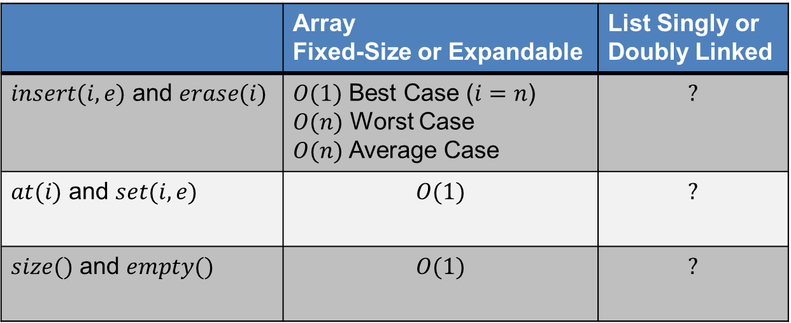
Vector Summary
 | Array Fixed-Size or Expandable | List Singly or Doubly Linked
$insert(i, e)$ and $erase(i)$ | $O(1)$ Best Case ($i=n$) $O(n)$ Worst Case $O(n)$Average Case | $$?$$
$at(i)$ and $set(i, e)$ | $$O(1)$$ | $$?$$
$size()$ and $empty()$ | $$O(1)$$ | $$?$$

Slide 12

Iterators and Positions
An iterator abstracts the process of scanning through a collection of elements
Can be implemented on most data structures in this course, e.g., vector and list
Methods of the Iterator ADT:
  $hasNext()$ – returns whether another element follows
  $next()$ – returns iterator for next element
  $elem()$ – return element at position, also known as dereference in C++ (* operator)
Iterators handle many operations in a uniform way
  Example – insert for list and vector take iterators so the functions are called the same way
  Traversal of data structure from $begin()$to $end()$

Slide 13
Lists and Sequences
Iterators (Ch. 6.2.1)
List ADT (Ch. 6.2.2)
Doubly linked list (Ch. 6.2.3)
Sequence ADT (Ch. 6.3.1)
Implementations of the sequence ADT (Ch. 6.3.2-3)

Slide 14

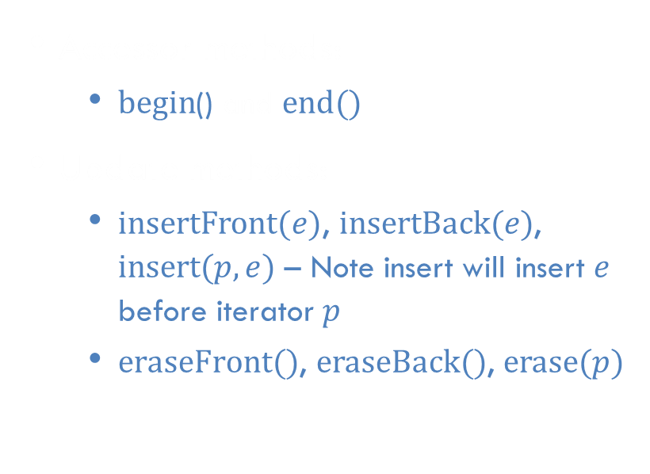
List ADT
The List ADT models a sequence of positions storing arbitrary objects
  establishes a before/after relation between positions
It allows for insertion and removal in the “middle”
Generic methods:
  $size()$ and $empty()$
Accessor methods:
  $begin$() and $end()$
Update methods:
  $insertFront(e)$, $insertBack(e)$, $insert(p, e)$ – Note insert will insert $e$ before iterator $p$
  $eraseFront()$, $eraseBack()$, $erase(p)$

Slide 15

$$insert\left(p, e\right)$$
p
A
B
C
p
A
B
q
C
X
p
q
A
B
X
C

Slide 16

$$erase(p)$$
p
A
B
C
D
A
B
C
p
D
A
B
C

Slide 17

Performance
Assume doubly-linked list implementation of List ADT
  The space used by a list with $n$ elements is $O(n)$
  The space used by each iterator of the list is $O(1)$
  All the operations of the List ADT run in $O(1)$time

Slide 18
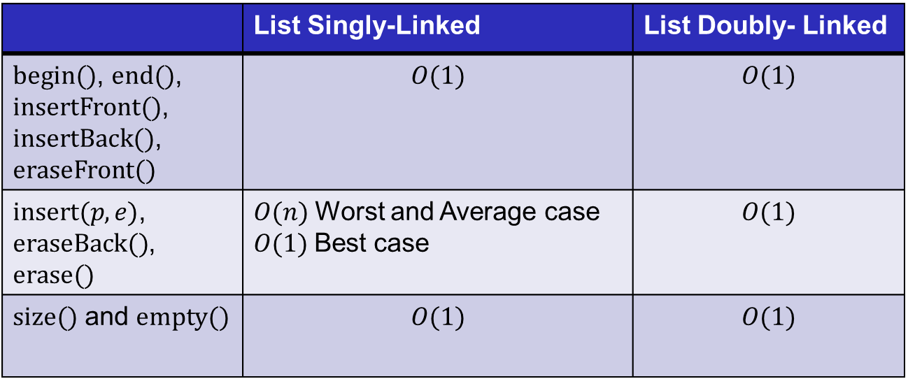
List Summary
 | List Singly-Linked | List Doubly- Linked
$begin()$, $end()$, $insertFront()$, $insertBack()$, $eraseFront()$ | $$O(1)$$ | $$O(1)$$
$insert(p, e)$, $eraseBack()$, $erase()$ | $O(n)$Worst and Average case $O(1)$Best case | $$O(1)$$
$size()$ and $empty()$ | $$O(1)$$ | $$O(1)$$

Slide 19

Sequence ADT
The Sequence ADT is a combination of the Vector and List ADTs
Elements accessed by
  Index or
  Iterator (Position)
All items in the List ADT plus the following “bridging” functions:
  $atIndex(i)$ – returns position of element at index $i$
  $indexOf(p)$ – returns index of element at position $p$

Slide 20
Applications of Sequences
The Sequence ADT is a basic, general-purpose, data structure for storing an ordered collection of elements
Direct applications:
  Generic replacement for stack, queue, vector, or list
  Small database (e.g., address book)
Indirect applications:
  Building block of more complex data structures

Slide 21

Array-based Implementation
elements
We use a circular array storing positions
A position object stores:
  Element
  Index
Indices $f$ and $l$keep track of first and last positions
0
1
2
3
positions
S
f
l

Slide 22
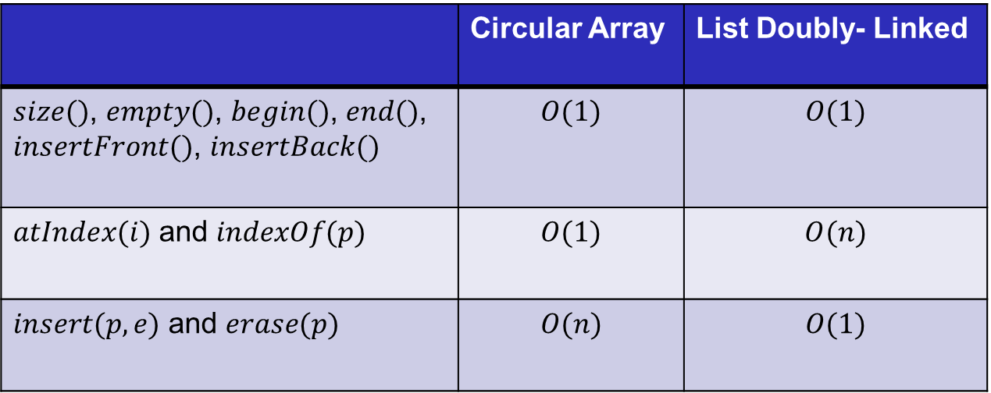
Sequence Implementations
 | Circular Array | List Doubly- Linked
$size()$, $empty()$, $begin()$, $end()$, $insertFront()$, $insertBack()$ | $$O(1)$$ | $$O(1)$$
$atIndex(i)$ and $indexOf(p)$ | $$O(1)$$ | $$O(n)$$
$insert(p, e)$ and $erase(p)$ | $$O(n)$$ | $$O(1)$$

Slide 23
Interview Question 1
Write code to partition a list around a value x, such that all nodes less than x come before all nodes greater than or equal to x.

Slide 24
Interview Question 2
Implement a function to check if a list is a palindrome.

